Slide 1
Inventory Management System
Names of People

Slide 2
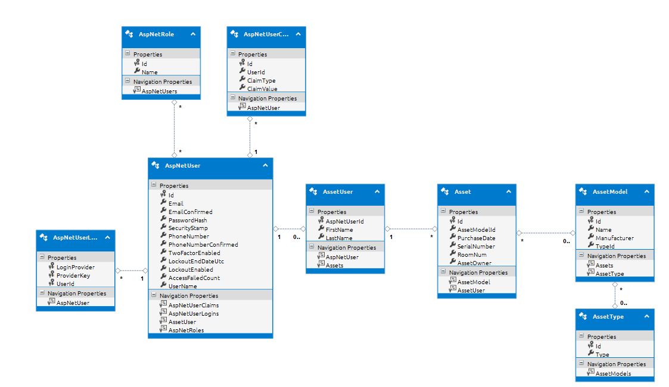
Class Model/EDMX

Slide 3
Asset Search

Slide 4
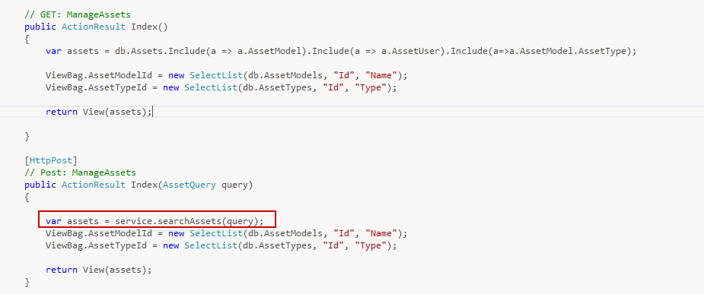
Controller

Slide 5
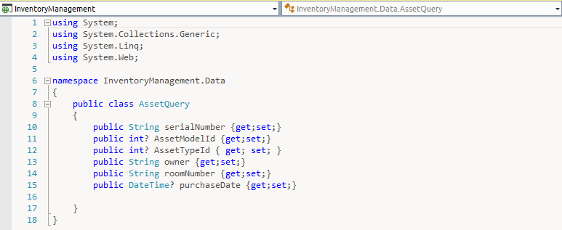
Query Class

Slide 6
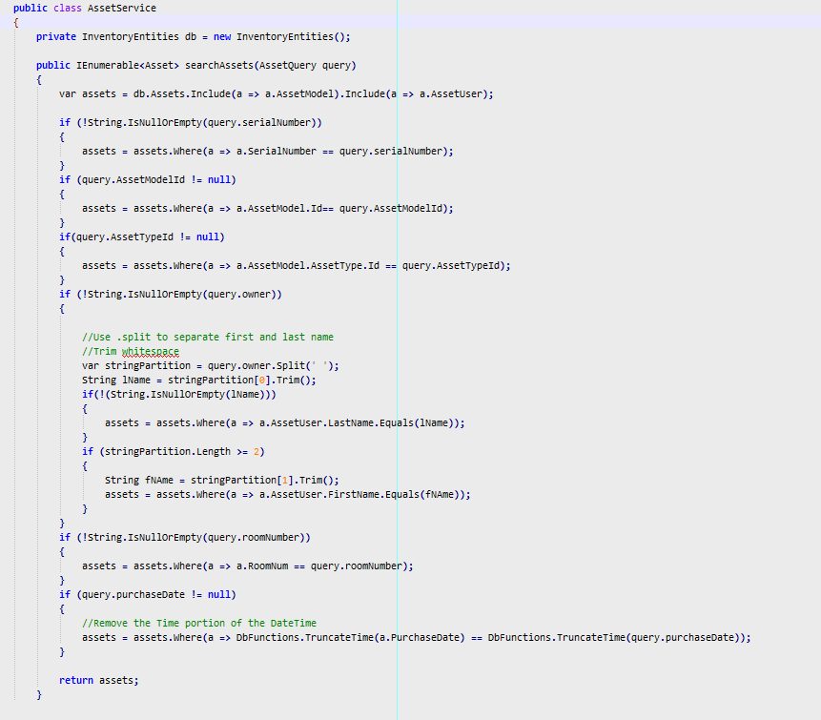
Search Logic

Slide 7
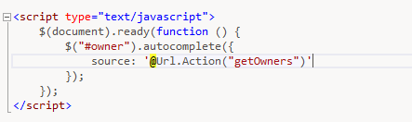
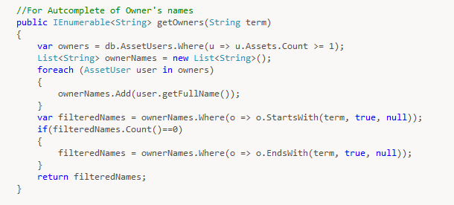
Autocomplete

Slide 8
Edit

Slide 9
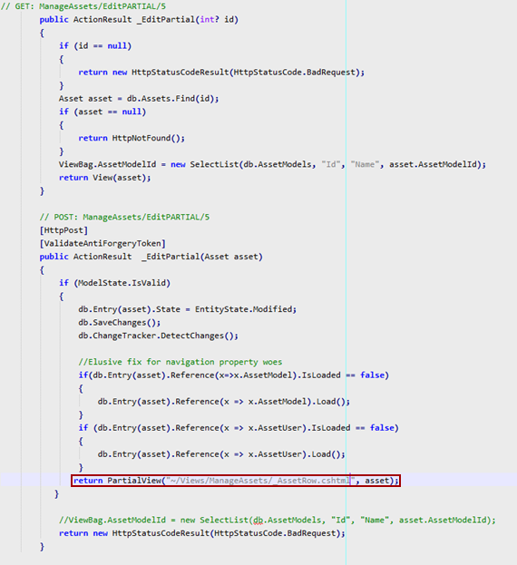
Controller

Slide 10
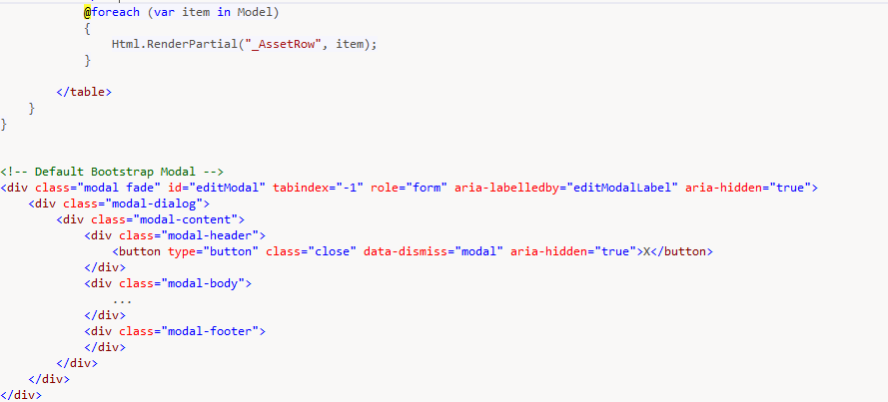
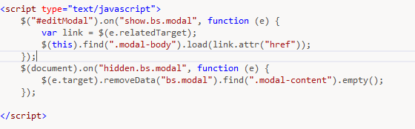
View – Partial Rows & Modal

Slide 11
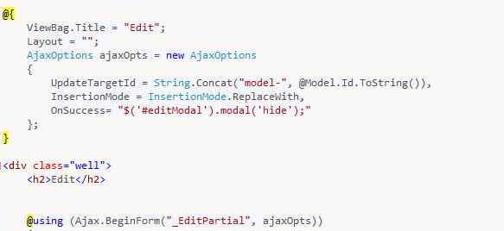
Ajax Form

Slide 12
ORM – Entity Framework
Uses simple common syntax (LINQ) to Add/Modify/Delete/Update objects.
No need to deal with writing SQL
Handles object-relational mapping (ORM) on its own.
Builds scaffolding for controllers and views based on models

Slide 13
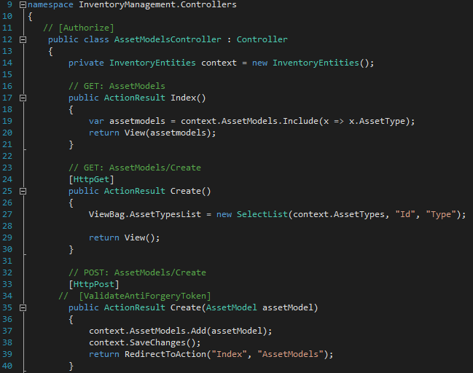
Asset Models – CRUD

Slide 14
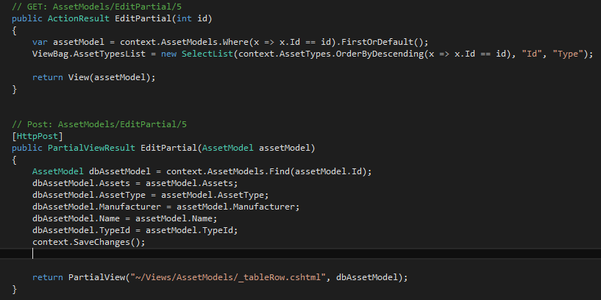
Asset Models - CRUD

Slide 15
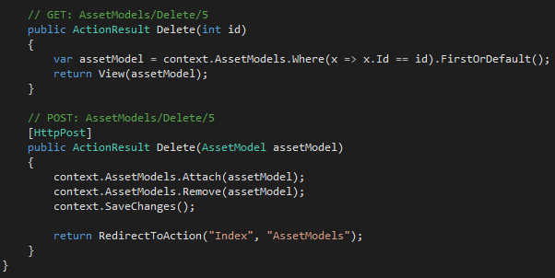
Asset Models - CRUD

Slide 16
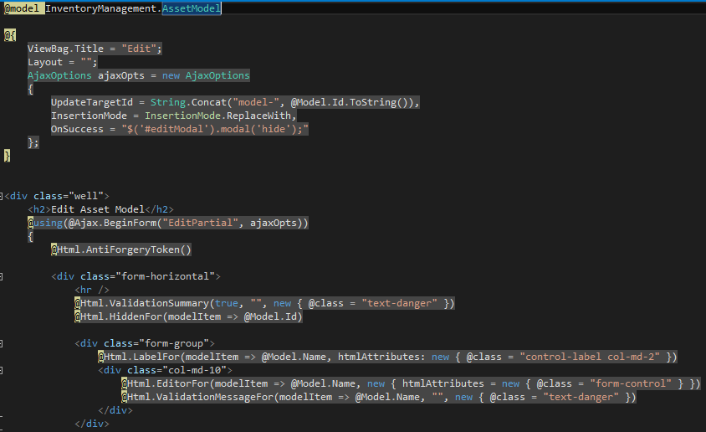
Asset Models – Edit View

Slide 17
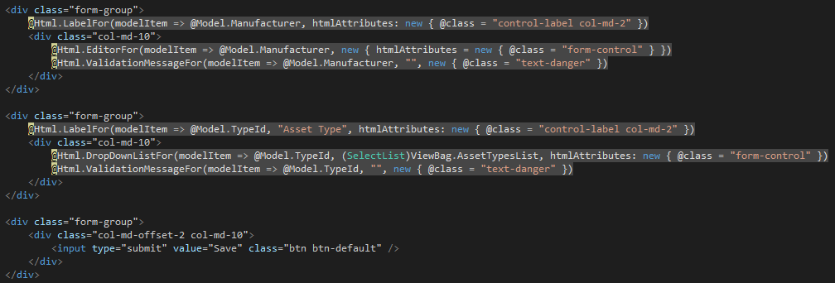
Asset Models – Edit View

Slide 18
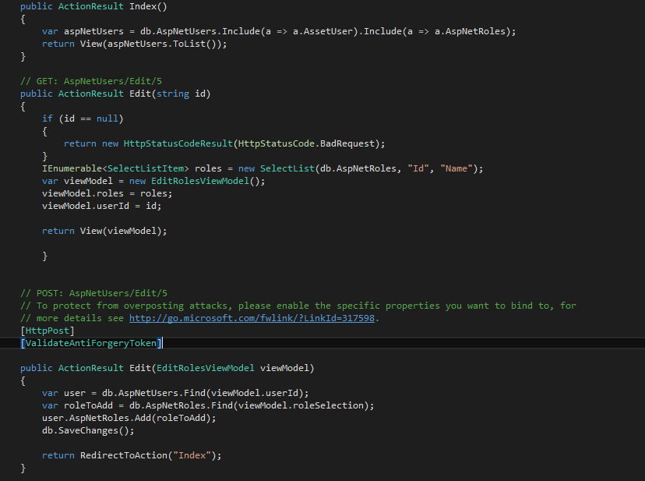
User Roles Page

